Slide 1


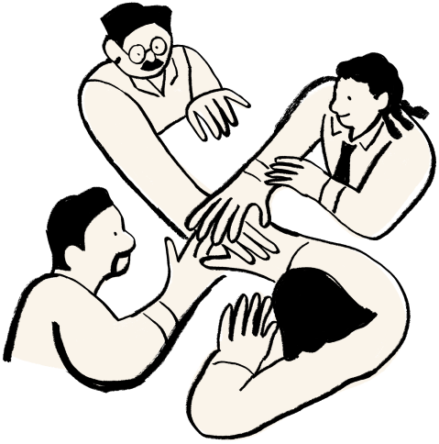



By: Gaurav, Maya, Simon, and Houston
Feb 16, 2025
Mobilyfe
Your Time, Your Mind, Your Lyfe
The technology that helps us use technology less

Slide 2






Table of Contents
Introduction
Learning and Critical Thinking
Code and Web App
Future Steps

Slide 3
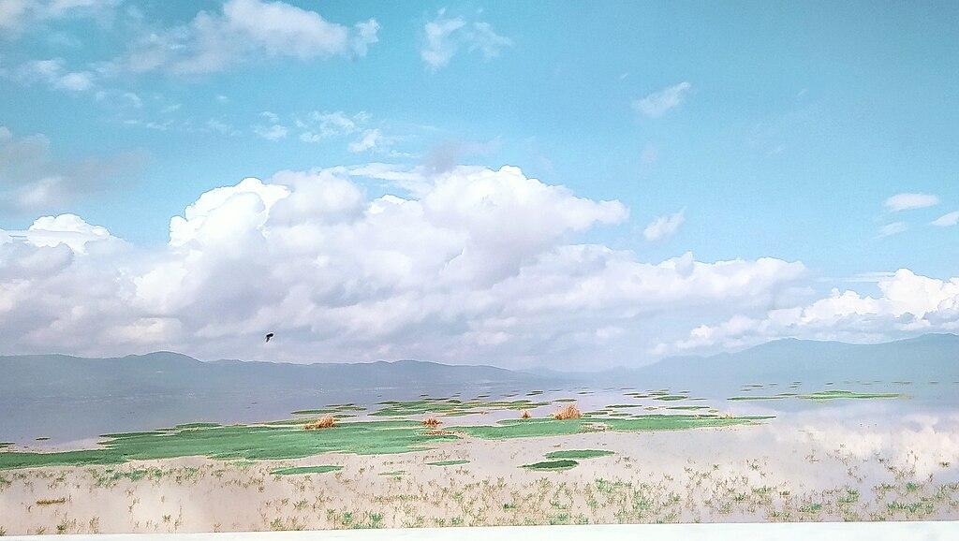

Like the balance in Miyazaki’s films between progress and preservation, we aim to efficiently use technology to better our lifestyle.
— someone

Slide 4



Introduction

Slide 5
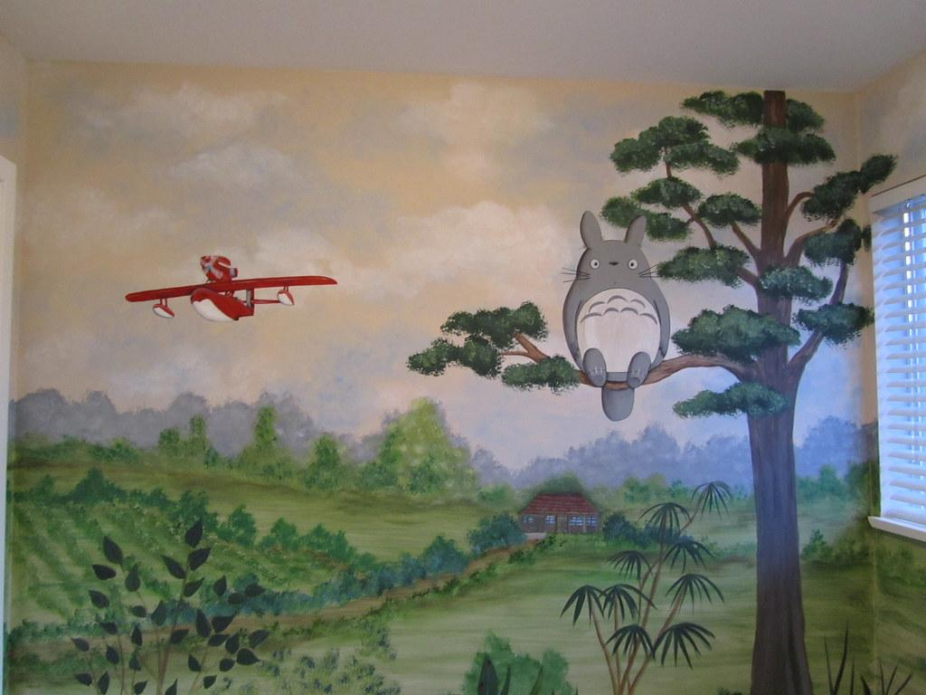

Challenge
In our tech-driven lives, it's easy to get lost in the hustle and forget to prioritize our well-being. By leveraging technology, we can create efficient plans that incorporate healthy eating, exercise, and meditation into our daily routines.
Our solution uses technology to help users manage their schedules better, ultimately encouraging them to spend less time on devices and more time on activities that promote physical and mental health.

Slide 6


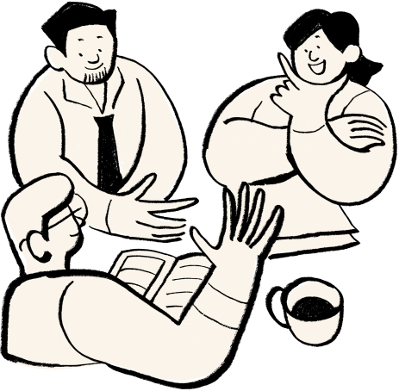
Learning and Critical Thinking

Slide 7



Work Process
Identify a Problem
Create a Solution
Create the Software
Connect the Pieces
When mental health is at an all-time low, how can we help revitalize the working class by fostering balance, reducing stress, and promoting meaningful connections?
Users can connect with nature, build new relationships, and stay on top of deadlines without stress.
Aiming to create personalized suggestions, provide important descriptions, and offer a structured way to stay organized.
Creating personalized suggestions, offering important descriptions, and providing a seamless way to stay organized.

Slide 8
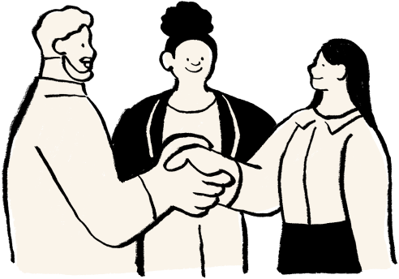

Implementation
Web Application
Our app uses your heart rate, steps, and past activity data to create a personalized schedule for meditation and physical activities.
This ensures the recommendations fit seamlessly into your daily routine, promoting better health and well-being.
Personalized Suggestions
Consolidating Deadlines
Meditation Reminders
Places in Your Area
Synchronized Schedules
Up to Date Descriptions

Slide 9


Code and Web App

Slide 10

Various Applications
Different Use Cases for Our Broad Demographic
Students | Remote Workers | Frequent Travelers | Busy Professionals | The Extraverts
Merges schedules, deadlines, and study sessions. | Syncs meetings, tasks, and deadlines. | Organizes trips and reservations. | Manages meetings and deadlines. | Finds events and hangouts.
Suggests study spots and cafés. | Recommends coworking spaces. | Suggests attractions and dining. | Finds networking spots. | Suggests meet-up locations.
Tracks assignments and exams. | Balances work and personal time. | Adjusts for time zones. | Sends smart reminders. | Syncs group plans.

Slide 11

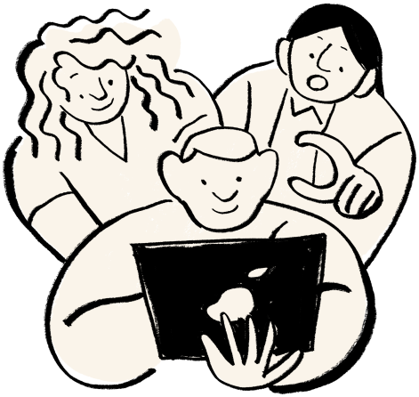
Future Steps

Slide 12


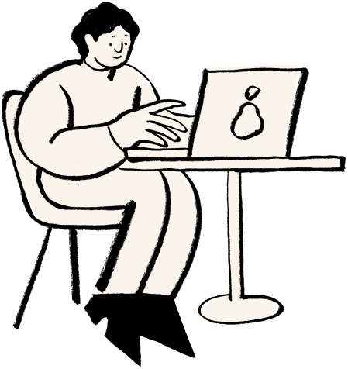

Features on the Way
Mobilife will continue allowing users to elevate their health and wellness through:
Hardware Integration
Refining our Suggestions
Developing a Mobile App
Collaborating with Other Wellness Apps
Tracking Sleep, Steps, and Exercise

Slide 13

Business Applications
To continue providing health and wellness suggestions to our users, Mobilyfe strives to provide future paid services with the following:
Provide access to premium features.
Advanced health analytics.
Personalized coaching.

Slide 14

Thank you!
Gaurav’s Shameless LinkedIn Plug
https://www.linkedin.com/in/gaurav-govindwani/
Simon’s Shameless LinkedIn Plug:
(Doesn’t have one)
Maya’s Shameless LinkedIn Plug
https://www.linkedin.com/in/mayae-spinosa/
Houston’s Shameless LinkedIn Plug
https://www.linkedin.com/in/houston-parkerr/

